Slide 1
Biologically Inspired Sleep Algorithm For Increased Generalization And Adversarial Robustness In Deep Neural Networks
Timothy Tadros
University of California, San Diego
ICLR 2020
2020-04-26

Slide 2
1
Overview
Contents
Problem
Verification
Conclusion
Inspiration
Scheme
Future
STDP
Spike
SNN
Post-synaptic Neuron
Integrate-and-fire Neurons
Spiking Neurons
Keywords
Pre-synaptic Neuron

Slide 3
2
Problem
Widely Problem
How to solve
Artificial Neural Networks (ANNs) lacks the ability of generalization
ANNs have been shown to underperform when the testing data differs in specific ways even by a small amount from the training data.
Two issues:
Natural distortion (no adversary)
ANNs are often trained on curated datasets of images designed to best capture the image content, whereas in real-world scenarios, they may be tested on disturbed or noisy inputs, not observed during training.
Attack (adversary)
ANNs are susceptible to adversarial attacks, or the deliberate creation of inputs designed to fool ANNs that may be imperceptibly different from correctly classified inputs.
Perspectives for investigating ANN robustness
Adversarial robustness
Scenario: Adversarial machine learning
Develop novel attack methods which perturb the input minimally while changing the ANN’s classification outcome.
Design defense mechanisms which prevent these attacks from affecting ANN behavior.
Manipulation robustness (Data Poisoning)
Scenario : Training data manipulation
Examines the impact of changing the input distribution during testing and observing the effect on ANN performance.
How to distort images in the test set:
Horizontal translations
Blurring
Add compression artifacts
Solutions for increasing adversarial and manipulation robustness
fine-tuning
Traditional methods are mostly ineffective or their effectiveness is inconclusive.
Newest Problem

Slide 4
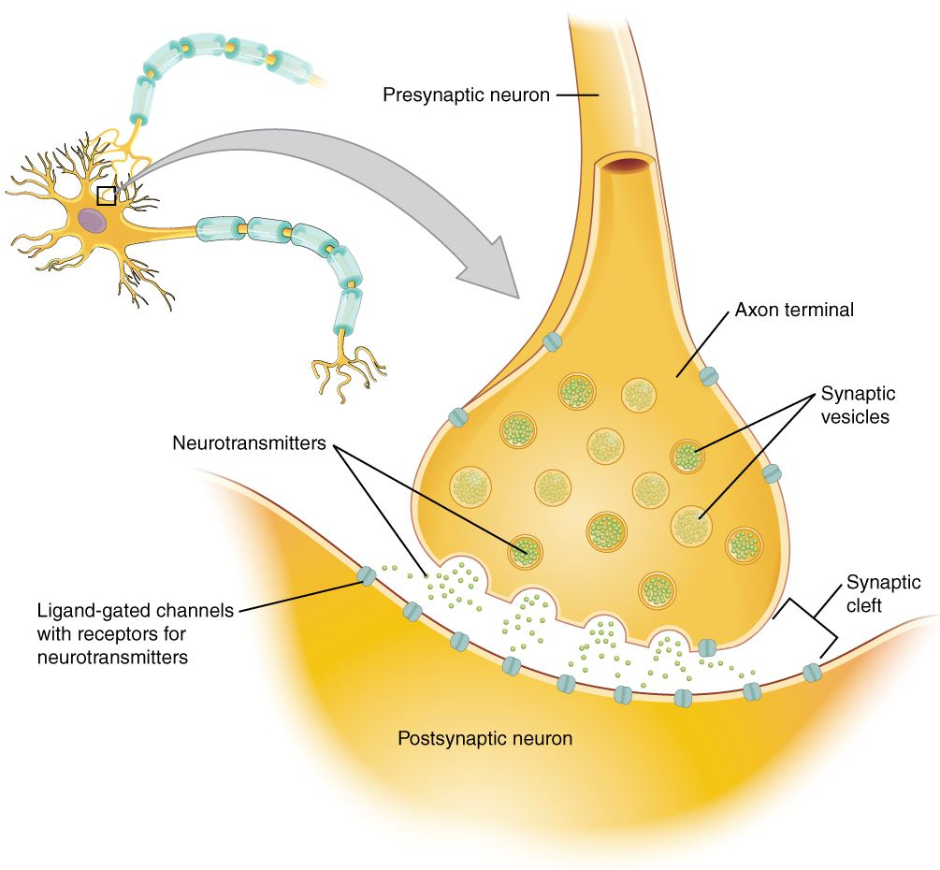
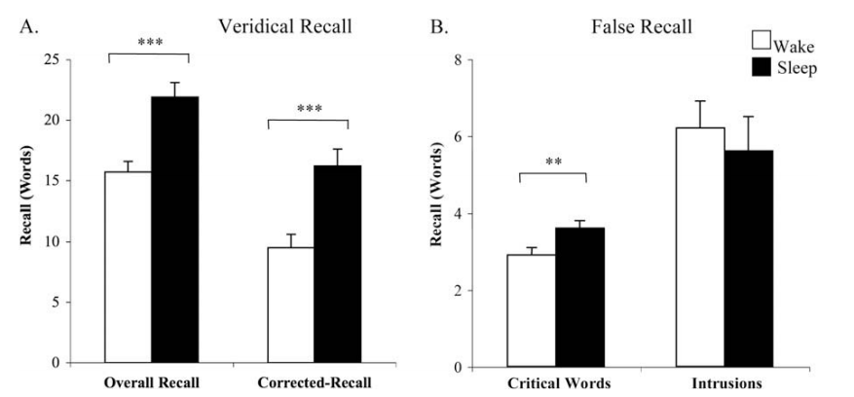
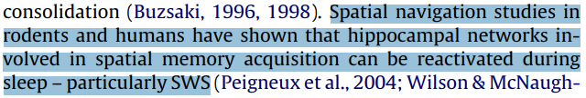
3
Inspiration
Difference between human and ANN
Humans are robust at behaving in the presence of noise and are capable of correctly classifying objects that are noisy, blurred, or otherwise distorted.
Why are humans robust ?
In animals and humans, sleep promotes generalization of knowledge and improves robustness against noise.
Why can sleep promote generalization ?
Plastic
Plastic changes during sleep can increase a subject’s ability to form connections between memories and to generalize knowledge learned during the awake.
Reactivation
Sleep reactivation, or replay, serves to strengthen synapses involved in a learned task through local synaptic plasticity, such as Spike Time Dependent Plasticity (STDP).
Synapses
Strengthened synapses help to create distinct representations for unique memories by devoting synapses to specific memory traces. Enable the network to extract the gist of the training data without being constrained by the statistics of a specific training data set.
Why can generalization improve robustness against noise ?
Sleep could aid in reducing a neural network’s susceptibility to adversarial attacks and to increase generalization performance by reducing the impact that imperceptible input changes can have on the task output.
Sleep-inspired Algorithm
Two targets:
to defend against adversarial attacks
to increase ANN robustness to noise
How to achieve targets?
Improve the ability of generalization.
How to improve generalization?
Apply an off-line unsupervised ”sleep” phase to modify the parameters of a fully connected ANN.
Learned task
The role of sleep in false memory formation-2009
Notes:
突触是指一个神经元的冲动传到另一个神经元或传到另一细胞间的相互接触的结构。一个神经元的轴突末梢经过多次分支，最后每一小支的末端膨大呈杯状或球状，叫做突触小体。突触小体可以与多个神经元的细胞体或树突相接触，形成突触。
ligand gate配体门

Slide 5
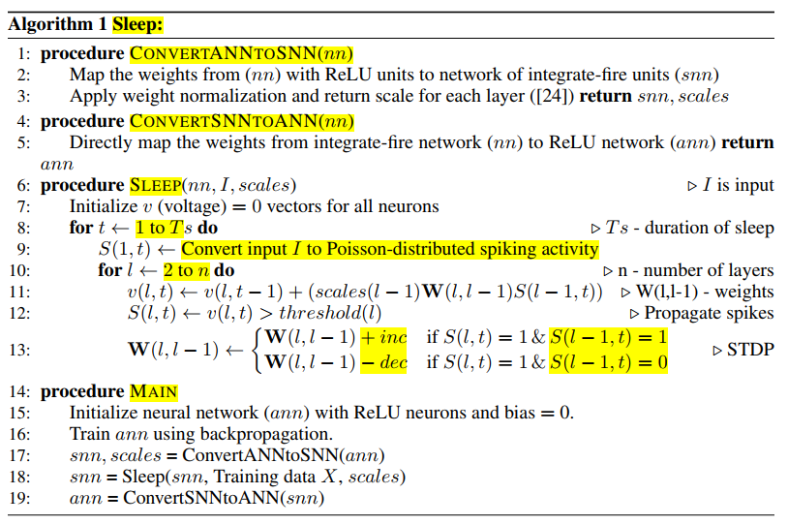


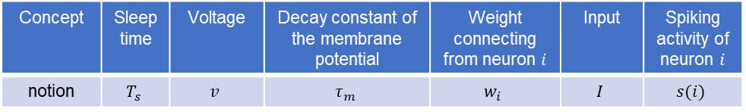
4
Scheme
Four steps in the proposed scheme
Train ANN using SGD
Convert ANN to a spiking neural network (SNN)
ReLU units (ANN weight) → integrate-fire units (SNN weight)
Weight normalization
Scale (the number of neurons) for each layer: $scales(n)$
Run a sleep phase which modifies the network connectivity based on spike-timing dependent plasticity (STDP)
Inputs to each neuron of the input layer must be presented as spiking activity (Poisson-distributed ).
How to convert inputs $I$ to spikes $S(1,t)$? Only one $I$, different $S(1,t)$
max firing rate $f_{max}$ (units $\frac{spikes}{sec}$) higher input value → higher spike rate
computing a Poisson-distributed spike raster
Compute voltage of layer $l$ in time $t$ : $v(l,t)$
If voltage exceeds the firing threshold, output spike $s(l,t)$
Apply STDP rule to update weights connecting with layer $l$
presynaptic spike induces a post-synaptic spike→ increase
post-synaptic spike occurs, but pre-synaptic does not spike → decrease
Convert SNN back into the ANN
integrate-fire units (SNN weight) → ReLU units (ANN weight)
Concept | Sleep time | Voltage | Decay constant of the membrane potential | Weight connecting from neuron $i$ | Input | Spiking activity of neuron $i$
notion | $$T_{s}$$ | $$v$$ | $$τ_{m}$$ | $$w_{i}$$ | $$I$$ | $$s(i)$$
Conversion Constraint
Basic intuition behind the sleep algorithm
A period of offline activity, whereby network weights are modified according to an unsupervised learning algorithm, allows the parameters of the network to become more reflective of the underlying statistics of the task at hand, while not overfitting the statistics of the training data.

Slide 6

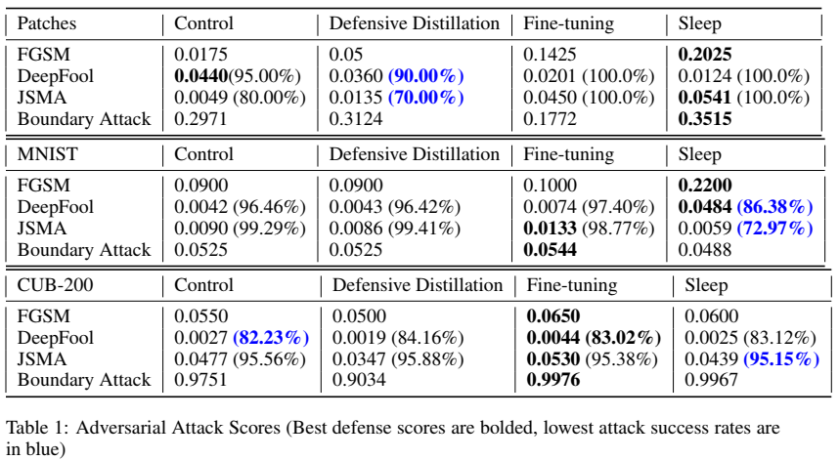


5
Verification
Four experimental networks
1st test network ()
Trained a control ANN using the training set for each of the main datasets used in this study.
2nd test network
Created a defensively distilled network using temperature $T = 50$.
3rd network
fine-tuned the control ANN on a specific attack or distortion method.
4th network
converted the control ANN to an SNN and applied the sleep algorithm.
How to test adversarial robustness of four networks ?
created adversarial examples for each of these four networks.
analyze how successful each attack is to fool each of the four networks.
How to test generalization distortion robustness of four networks ?
creating four different networks
tested each network on varying levels of distortion
Data sets
Patches (a toy dataset，four binary images，10x10)
MNIST (handwritten digits, 60k+10k greyscale images, 28x28 )
CUB-200 (high resolution dataset of images of birds, 200 species x30)
Evaluation metrics
Adversarial robustness
DeepFool/ JSMA/ Boundary attack
adversarial example for input $x_{i}$ : ${x_{i}}^{′}$
dimension of the space: $N$
total score $S_{A}$ for an attack：
FGSM
computes the median minimum noise level needed to produce a misclassification across all samples

Slide 7
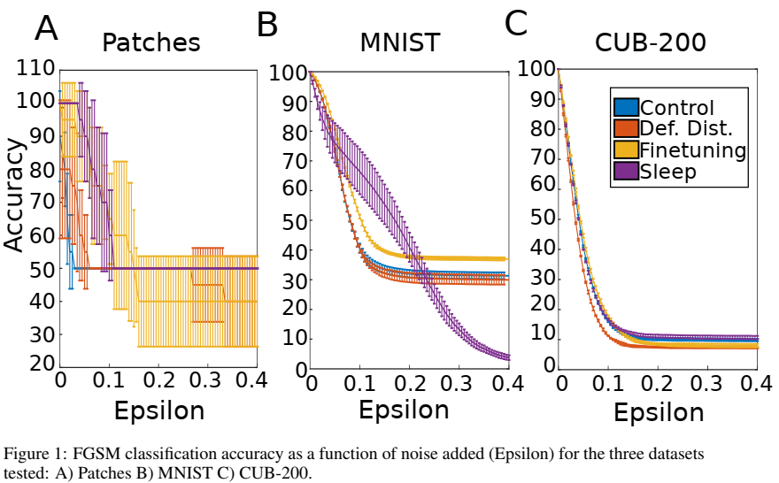
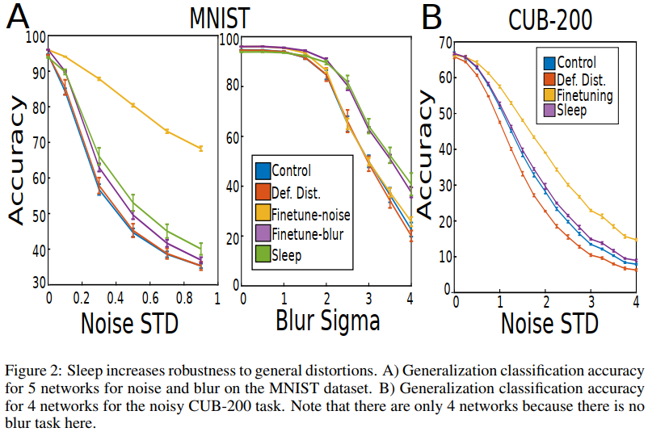
5
Verification
Adversarial robustness results
FGSM attack
sleep algorithm increases the median minimum noise needed for misclassification for all three datasets compared to the control network. (相同accuracy时, sleep所需扰动eplison最大,说明防御有效)
In sum, these results indicate that a sleep phase can successfully mitigate FGSM, more so than a control network.
Evaluation metrics
Generalization distortion robustness
noisy distortions
Blurry distortions
Generalization distortion robustness results
Overall, fine-tuning on an image distortion results in the best performance for that specific distortion. But, fine-tuning on a specific distortion does not extend to other types of distortions. (可以改进)
The sleep algorithm increased performance for both distortion methods, since this approach is not tailored to any one representation of the training set.
How sleep increases robustness on blur and noise distortions?
In biological systems, sleep increases generalization through replay of memories learned during awake which leads to changes in synaptic weights. These changes entail both an increase in synaptic weights associated with a specific task and pruning of synapses involved in other tasks.

Slide 8
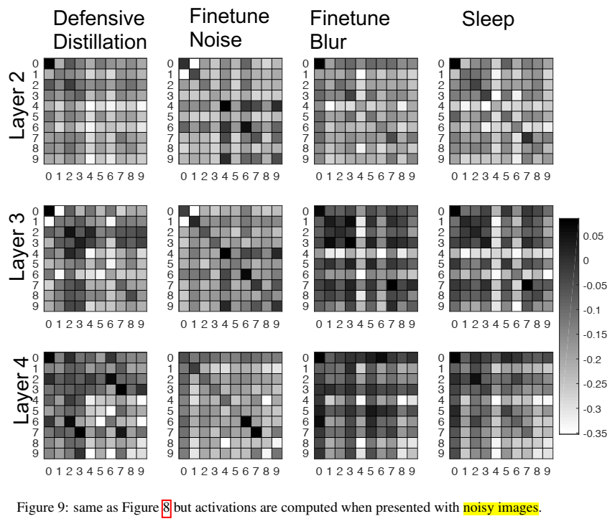
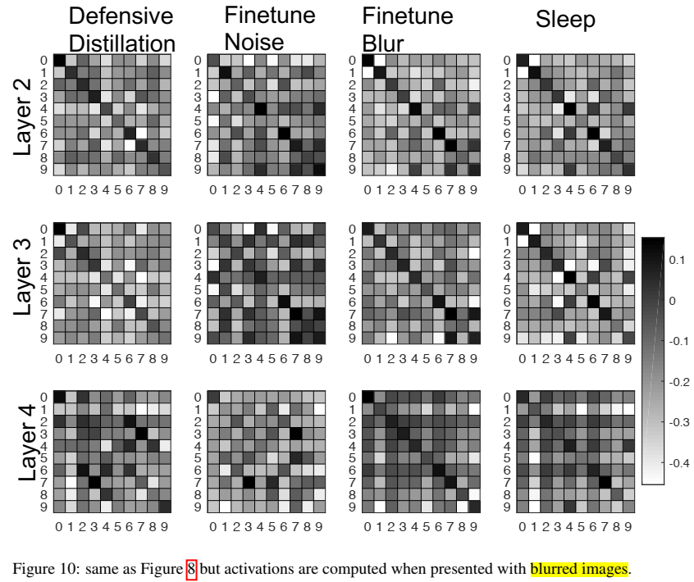
5
Verification
correlations among like digits in the hidden layers of the network are greater after applying sleep than before for noisy and blurred images.

Slide 9
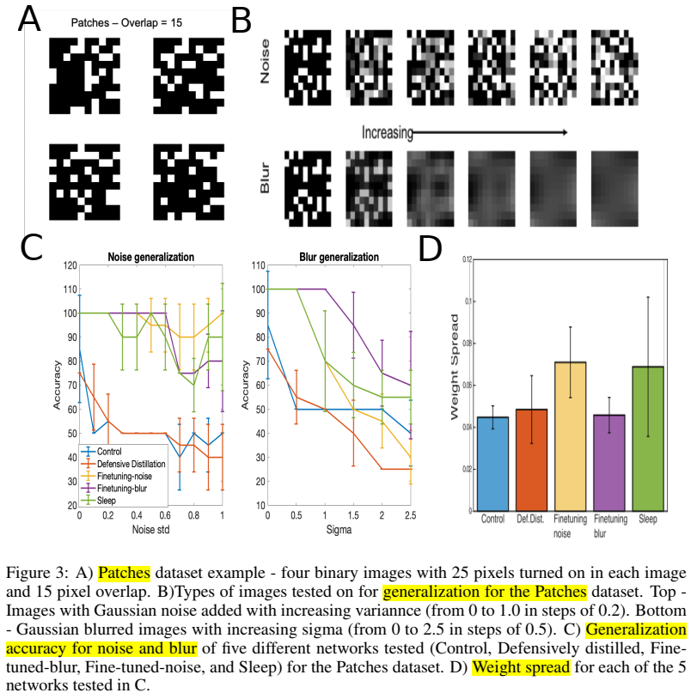
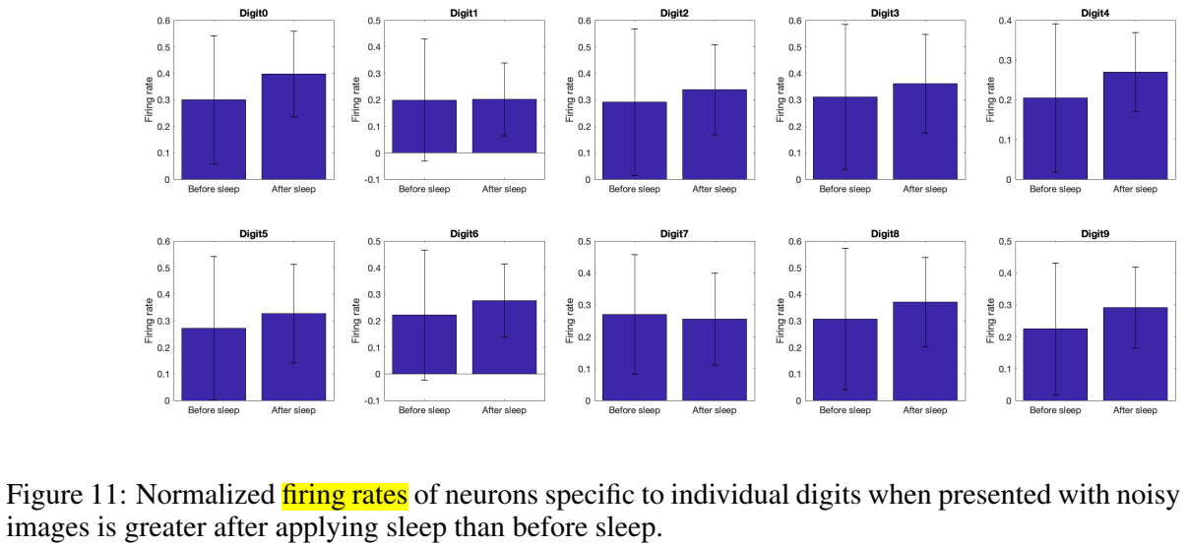
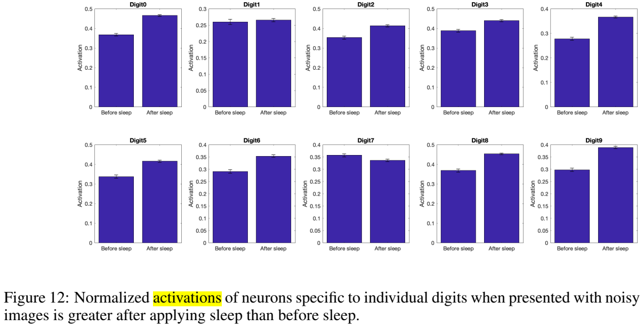
5
Verification
both normalized spiking activity and activations of digit-specific neurons are higher after sleep than before.

Slide 10
6
Conclusion

Slide 11
7
Future

Slide 12

Thank you !
Mengdie Huang
Group AI Security
Lab Ruiyun
2020-9-3

